Slide 1


NEXT GEN EMPLOYABILITY PROGRAM
CREATING A FUTURE-READY WORKFORCE
Student Name :
Sandeep S K
Student ID :
College Name :
STU67bb611cced0a1740333340
Jain Institute of Technology,Davangere

Slide 2
CAPSTONE PROJECT SHOWCASE
A Service for Delivering Food (Zomato Clone) with MERN Technology​
Abstract | Problem Statement | Project Overview | Proposed Solution | Technology Used | Modelling & Results | Conclusion | Q&A

Slide 3
Abstract
1
Food Delivery Platform – A MERN-based Zomato Clone enabling users to browse restaurants, add food items, and place orders.
2
Real-Time Updates & Order Management – Ensures instant reflection of restaurant listings, menu changes, and order processing in the system.
3
Secure Authentication & User Management – Implements JWT and bcrypt for user authentication, ensuring secure login, registration, and admin access
4
MERN Stack Deployment & Scalability – Uses MongoDB Atlas (database), Express.js & Node.js (backend), React.js (frontend), Render (backend hosting), and Vercel (frontend hosting) for a scalable and efficient system

Slide 4


Problem Statement
There is a need for a real-time, secure, and user-friendly food delivery system that allows users to browse restaurants, add food items, and place orders with instant updates. Existing platforms often lack real-time synchronization and secure authentication.
This project solves these issues by building a Zomato Clone using the MERN stack, enabling instant updates, secure user login, and efficient restaurant and order management.

Slide 5

Project Overview
The MERN-based Zomato Clone is a real-time, cloud-integrated food delivery system ensuring seamless restaurant management, dynamic menu updates, and efficient order processing.
Secure Authentication – JWT-based security with bcrypt encryption for user and admin access.
Real-Time Synchronization – Instant database updates via MongoDB Atlas & RESTful APIs.
Scalable Cloud Deployment – Render (backend) & Vercel (frontend) for high-performance accessibility.

Slide 6
Proposed Solution
Full-Stack Architecture – React.js (frontend), Node.js & Express.js (backend), and MongoDB Atlas (database) for seamless restaurant, menu, and order management.
Real-Time Data Synchronization – Instant restaurant additions, menu updates, and order tracking using RESTful APIs & MongoDB Atlas.
Secure Authentication & User Management – JWT-based authentication with bcrypt encryption for user and admin access control.
Cloud Deployment & Scalability – Backend hosted on Render, frontend deployed on Vercel, ensuring high availability & performance.

Slide 7
Technology used
Frontend(client-side) :
React.js | Component-based UI for a dynamic and responsive interface
React Router | Navigation management for seamless routing between pages
Tailwind CSS / Bootstrap | Styling and responsive design
Axios / Fetch API | Handling HTTP requests to the backend
Database and storage:
MongoDB Atlas | Cloud-based NoSQL database for storing users, restaurants, menu items, and orders.

Slide 8
Technology used
Backend (Server-Side) :
Node.js | JavaScript runtime for handling server-side logic.
Express.js | Framework for building RESTful APIs and handling requests.
JWT/JSON Web Token | Secure authentication for users and admins.
bcrypt.js | Password hashing for enhanced security.
Deployment & Hosting:
Render | Cloud platform for deploying the backend (Node.js & Express server).
Vercel | Hosting the frontend (React.js) for scalability and performance.

Slide 9
Technology used
Additional Tools & Technologies:
Postman | API testing for backend endpoints.
Git & GitHub | Version control and collaborative development.
Dotenv | Environment variable management for secure API keys and database credentials.

Slide 10
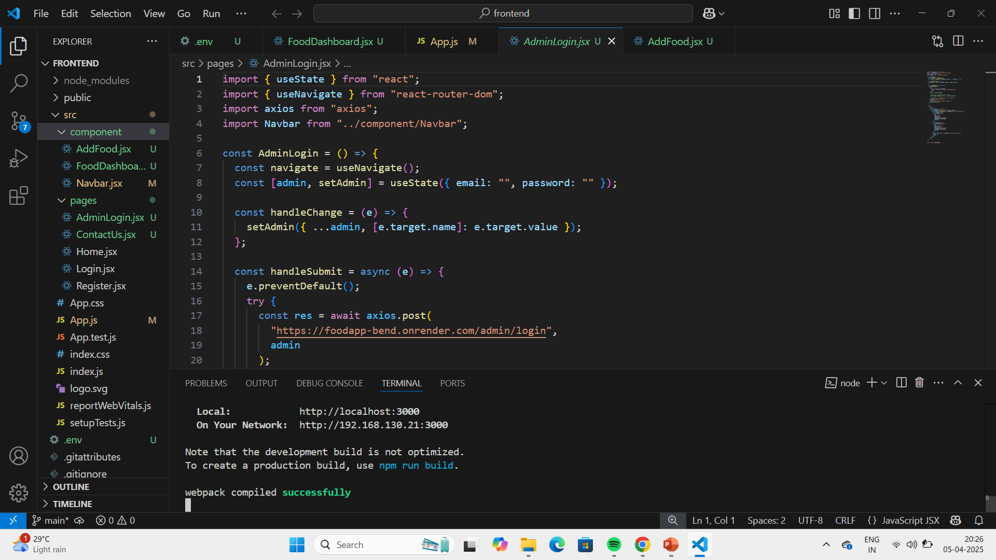
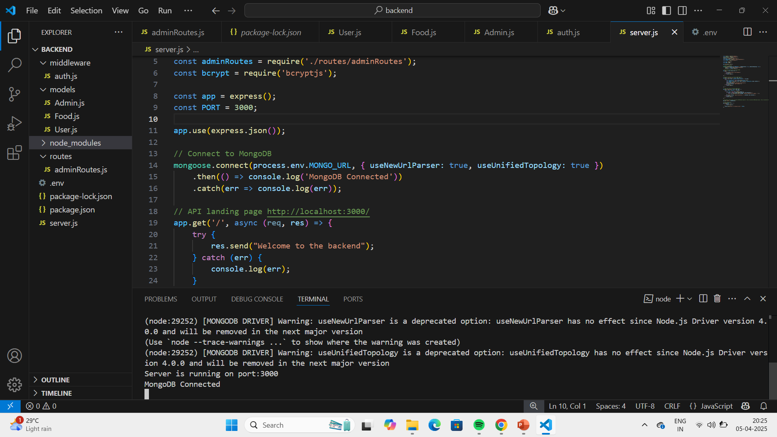
Modelling & Result
Fig. Frontend Code Folder
Fig. Backend code Folder

Slide 11
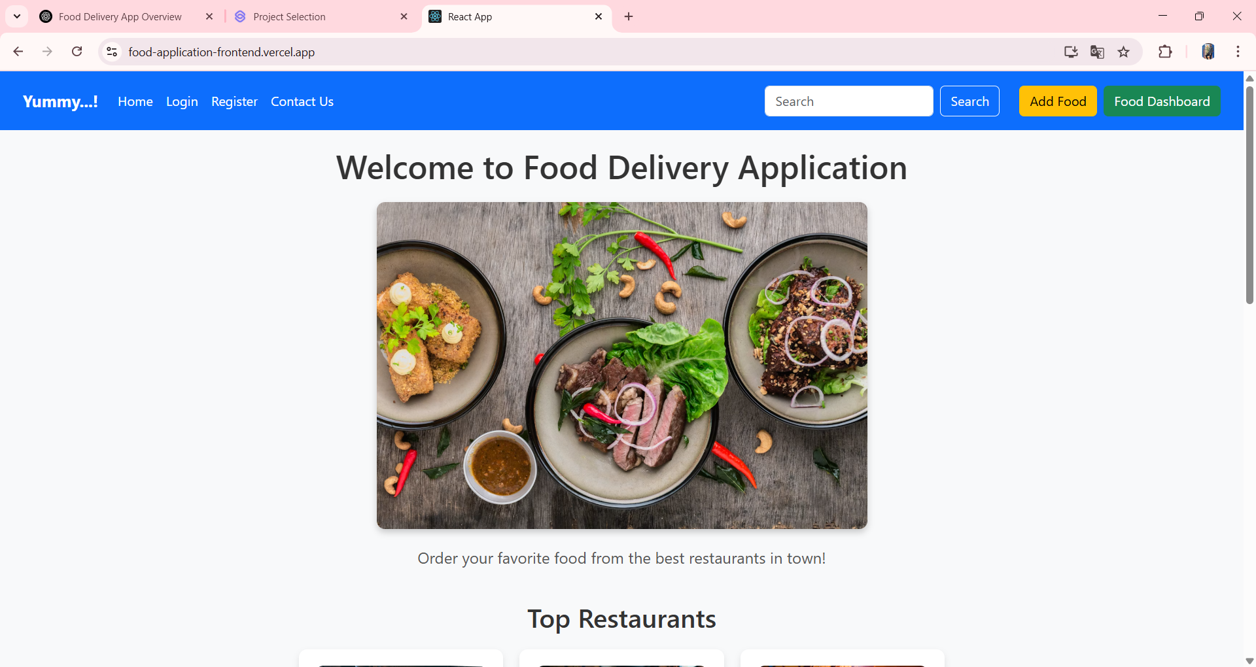
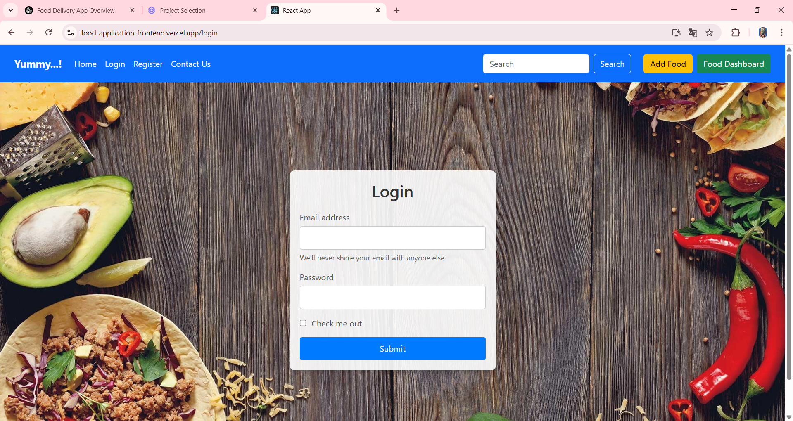
Modelling & Result
Fig. Home Page
Fig. User Login Page

Slide 12
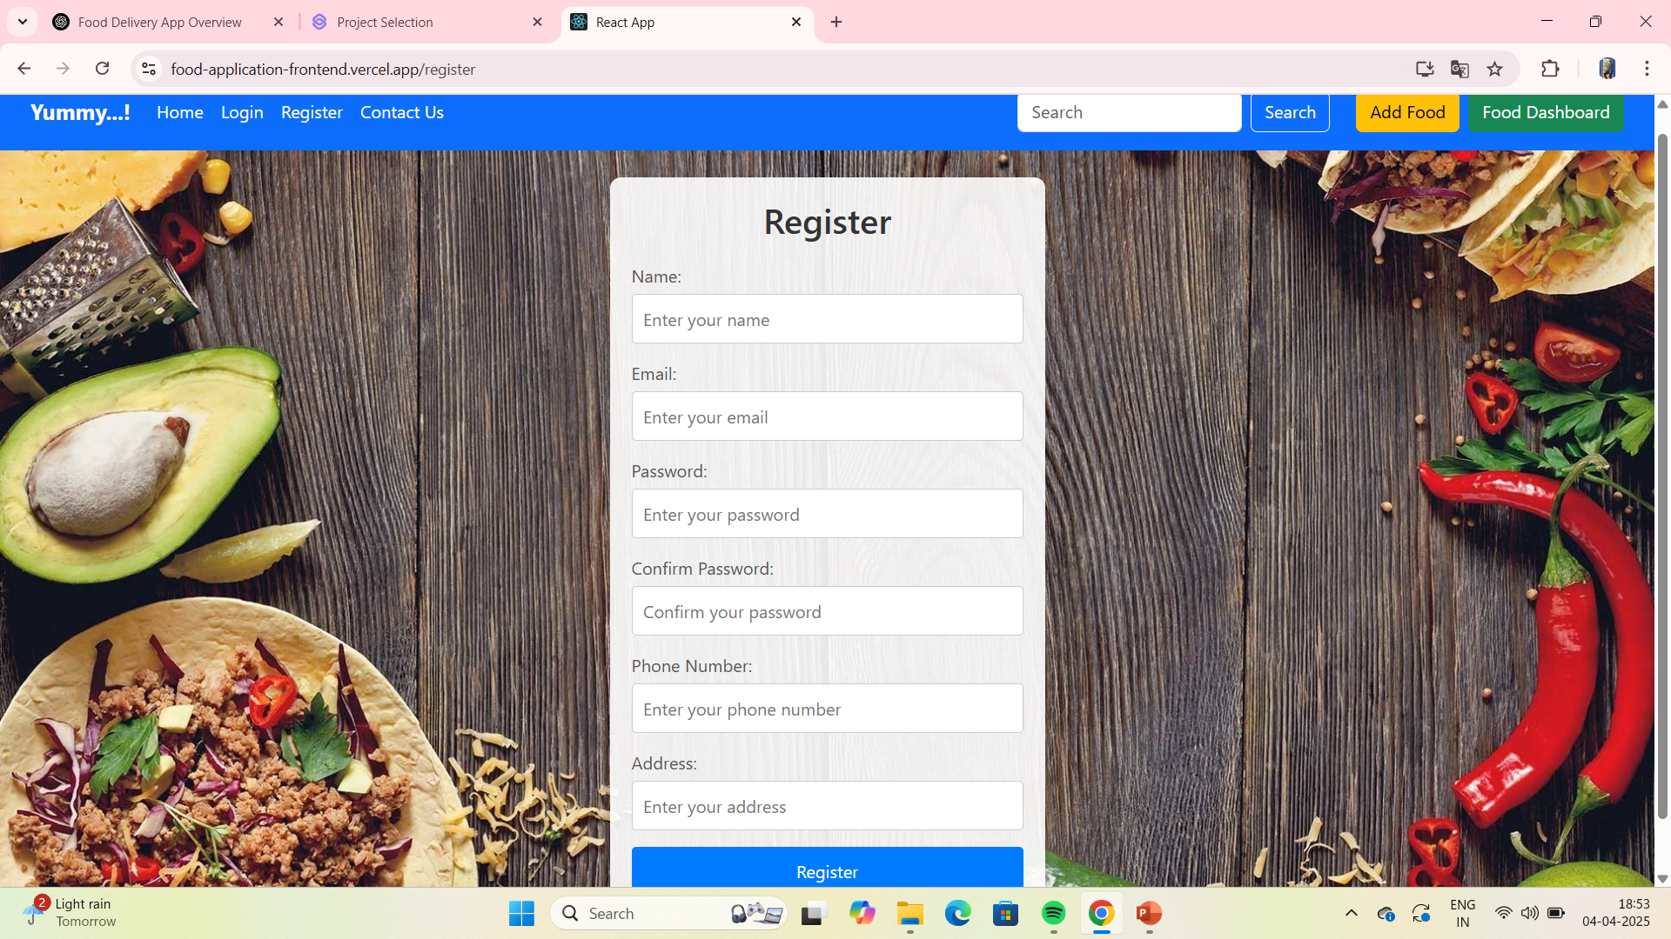
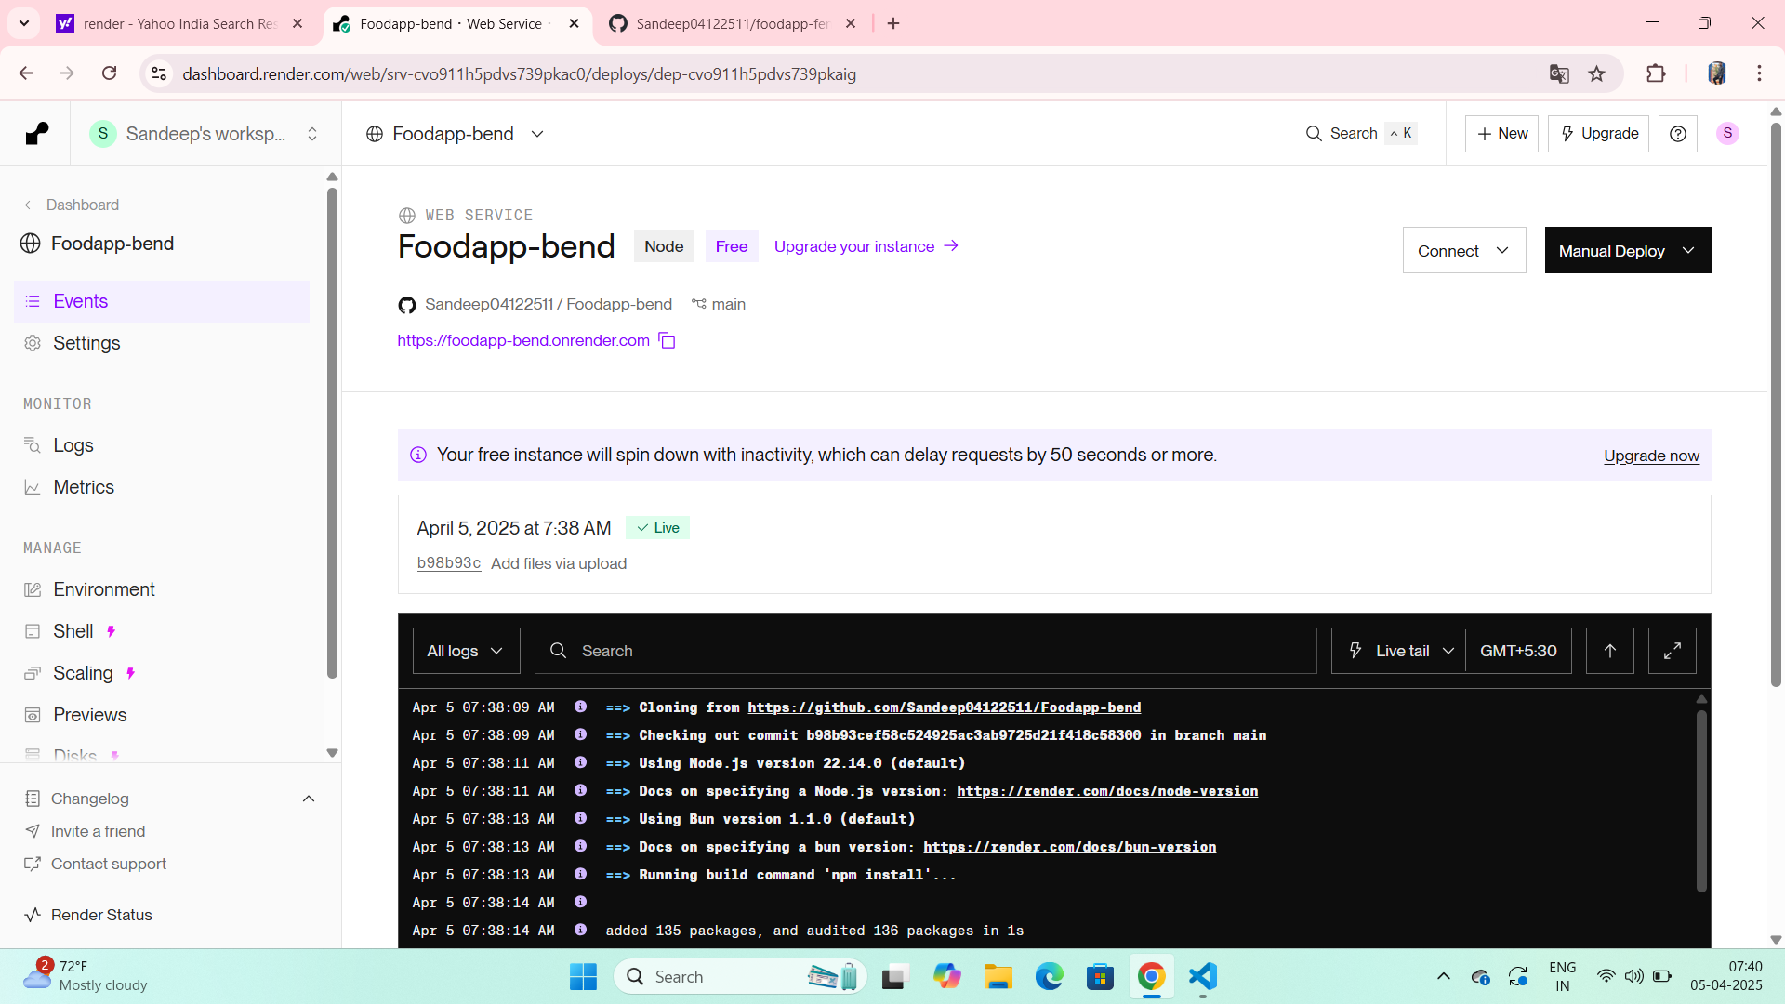
Modelling & Result
Fig. User Registration
Fig. Deployment of Backend in Render

Slide 13

Conclusion
The Zomato Clone using MERN stack successfully demonstrates a full-stack, real-time food delivery application with features like secure authentication, restaurant and menu management, and instant order updates. By integrating MongoDB Atlas, Express.js, React.js, and Node.js, along with cloud deployment on Render and Vercel, the project ensures scalability, performance, and a smooth user experience.
This project not only fulfills the functional requirements of a food delivery system but also provides practical hands-on experience in modern web development, making it a strong foundation for building real-world, scalable applications.

Slide 14
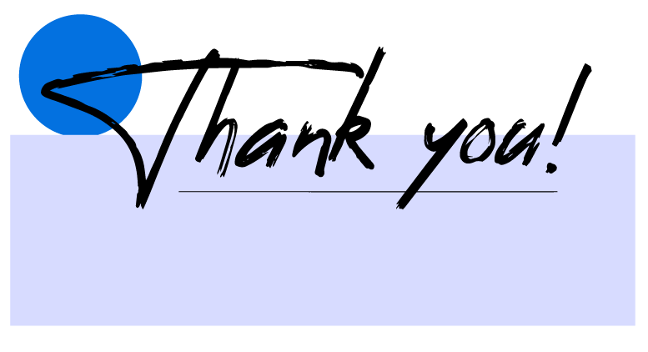

Notes:
Thank You !!

